Slide 1


CheckedListbox

Slide 2
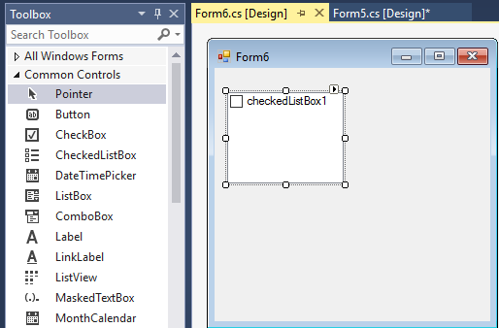
CheckedListbox

Slide 3
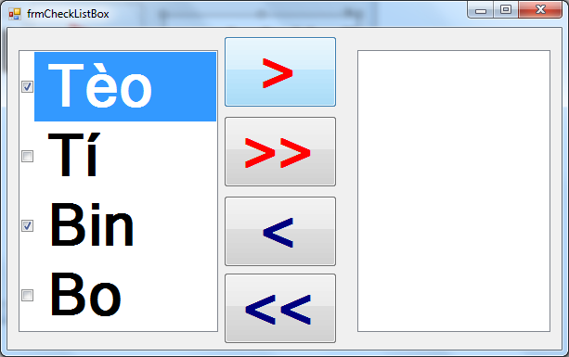
CheckedListbox
Control cho phép hiển thị danh sách có Checked đằng trước các dòng dữ liệu
btnAdd
btnAddAll
chklbLeft
chklbRight
btnRemove
btnRemoveAll

Slide 4
Use Items to add data
private void frmCheckListBox_Load
(object sender, EventArgs e)
{ chklbLeft.Items.Add("Tèo"); chklbLeft.Items.Add("Tí"); chklbLeft.Items.Add("Bin"); chklbLeft.Items.Add("Bo");
}
Or we could use AddRange
chklbLeft.Items.AddRange(new string[] { "Tèo","Tí","Bin","Bo"});

Slide 5
How to process Items Checked???
Case 1:
CheckedListBox.CheckedIndexCollection indexCollection = chklbLeft.CheckedIndices;
string strChecked = "";
foreach (int i in indexCollection)
{
strChecked += i + ";";
}
MessageBox.Show(strChecked);

Slide 6
How to process Items Checked???
Case 2:
CheckedListBox.CheckedItemCollection items = chklbLeft.CheckedItems;
string strChecked = "";
foreach (string s in items)
{
strChecked += s + ";";
} MessageBox.Show(strChecked);

Slide 7
How to process Items Checked???
Case 3:
string strChecked = "";
for (int i = 0; i < chklbLeft.Items.Count; i++){
if (chklbLeft.GetItemChecked(i))
{
//Process Item checked here
}
}

Slide 8
Go back ChecklistBox Example:
private void btnAdd_Click
(object sender, EventArgs e)
{
foreach(int i in chklbLeft.CheckedIndices)
{
chklbRight.Items.Add(chklbLeft.Items[i]);
}
foreach (string s in chklbRight.Items)
{chklbLeft.Items.Remove(s);}
}

Slide 9
private void btnAddAll_Click
(object sender, EventArgs e)
{ chklbRight.Items.AddRange
(chklbLeft.Items); chklbLeft.Items.Clear();
}

Slide 10
private void btnRemove_Click
(object sender, EventArgs e)
{
foreach (string s in chklbRight.CheckedItems)
chklbLeft.Items.Add(s);
foreach(string s in chklbLeft.Items)
chklbRight.Items.Remove(s);
}

Slide 11
private void btnRemoveAll_Click
(object sender, EventArgs e)
{
chklbLeft.Items.AddRange
(chklbRight.Items);
chklbRight.Items.Clear();
}

Slide 12


Hey! Coding is easy!
END

